Slide 1
Predicting Patient Appointment No Show

Slide 2
Straight from DB : Features
Predict This : 'Source Appointment Status' ➔ Y
'Hosp Code',
'Appointment Sequence',
'Health Service Code',
'Datetime of Appointment',
'Date Of Appointment Booked',
'Clinic Category',
'Time of Slot',
'Duration of Appointment',
'Time Of Arrival',
'Source Appointment Reason',
'Appointment Reason',
'Indigenous Status at Apppointment',
'Postcode at Appointment',
'Count of Patient Attended Appointments',
'Count of Referred to Inpatients',
'Is Interpreter Required',
'Age',
'DayOfWeekShort',
'MonthNameShort',
'24Hour',
'Postcode',
'Gender',
'CountryOfBirth',
'MinTemp',
'MaxTemp',
'rainfall',
'Account Type',

Slide 3
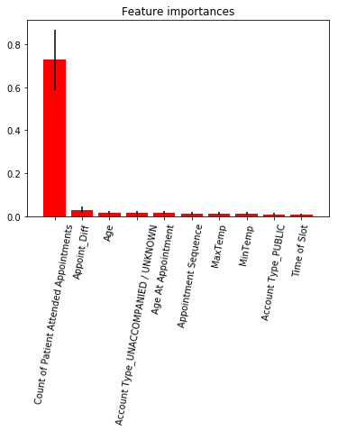
Result
Feature ranking:
1. feature Count of Patient Attended Appointments (0.726828)
2. feature Appoint_Diff (0.030032)
3. feature Age (0.014685)
4. feature Account Type_UNACCOMPANIED / UNKNOWN (0.014211)
6. feature Appointment Sequence (0.013185)
7. feature MaxTemp (0.012752)
8. feature MinTemp (0.012626)
9. feature Account Type_PUBLIC (0.008252)
10. feature Time of Slot (0.008150)

Slide 4
Confusion Matrix
True | Predicted
 | ATTENDED | BOOKED | NO ATTENDANCE | ALL
ATTENDED | 538482 | 0 | 2 | 538484
BOOKED | 50 | 121 | 269 | 440
NO ATTENDANCE | 933 | 8 | 53645 | 54586
SUSPENDED | 0 | 0 | 5 | 5
ALL | 539465 | 129 | 53921 | 593515

Slide 5
Confusion Matrix in Percentages
True | Predicted
 | ATTENDED | BOOKED | NO ATTENDANCE
ATTENDED | 99.817782 | 0.00000 | 0.003709
BOOKED | 0.009268 | 93.79845 | 0.498878
NO ATTENDANCE | 0.172949 | 6.20155 | 99.488140
SUSPENDED | 0.000000 | 0.000000 | 0.009273

Slide 6
Conclusion
This Model can predict NO ATTENDANCE with about 0.98 recall rate & about 0.99 accuracy

